Slide 1
NE 795-014: Advanced Reactor Materials
Fall 2023
Dr. Benjamin Beeler

Slide 2
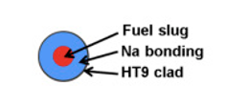
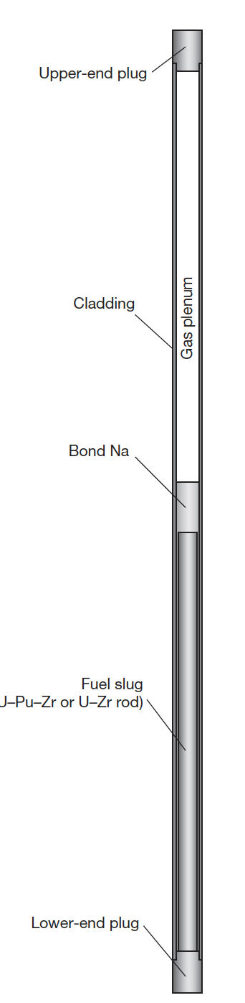
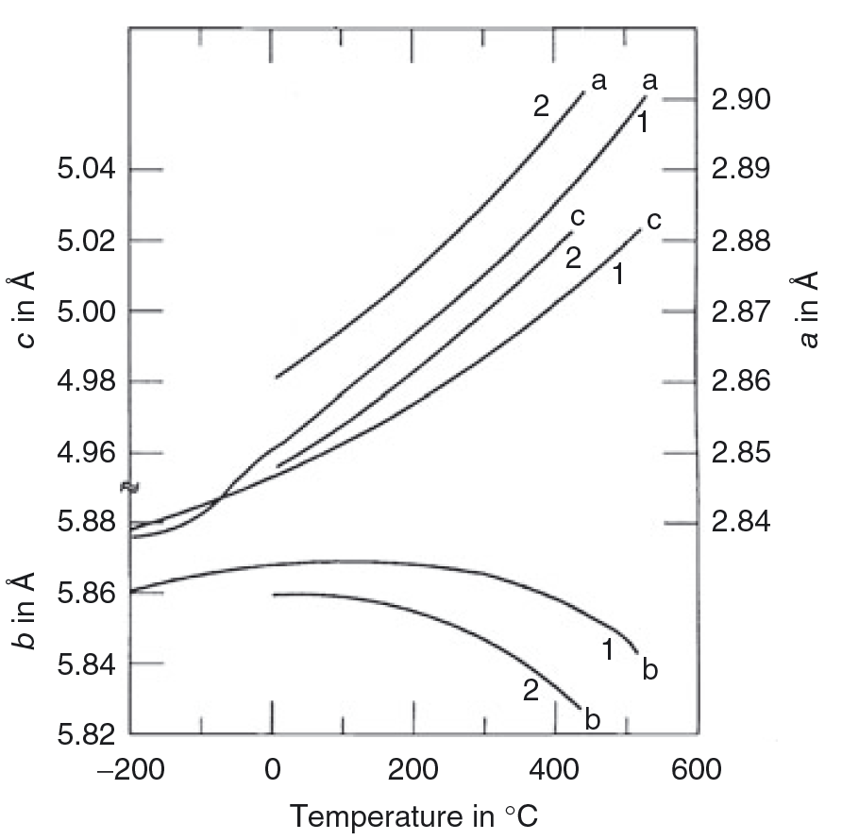
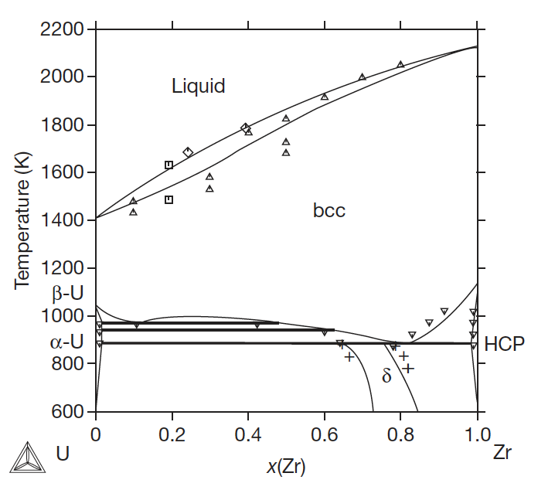
Last Time
SFRs and Metallic Fuel
Inherent safety associated with high thermal conductivity, large margin to boiling for Na, negative reactivity
Alpha U undergoes anisotropic expansion and irradiation growth
Alloy to stabilize gamma phase and improve properties
Swelling is inevitable, anisotropic, and can be accommodated with lower smear density
Different phases have different swelling behaviors

Slide 3
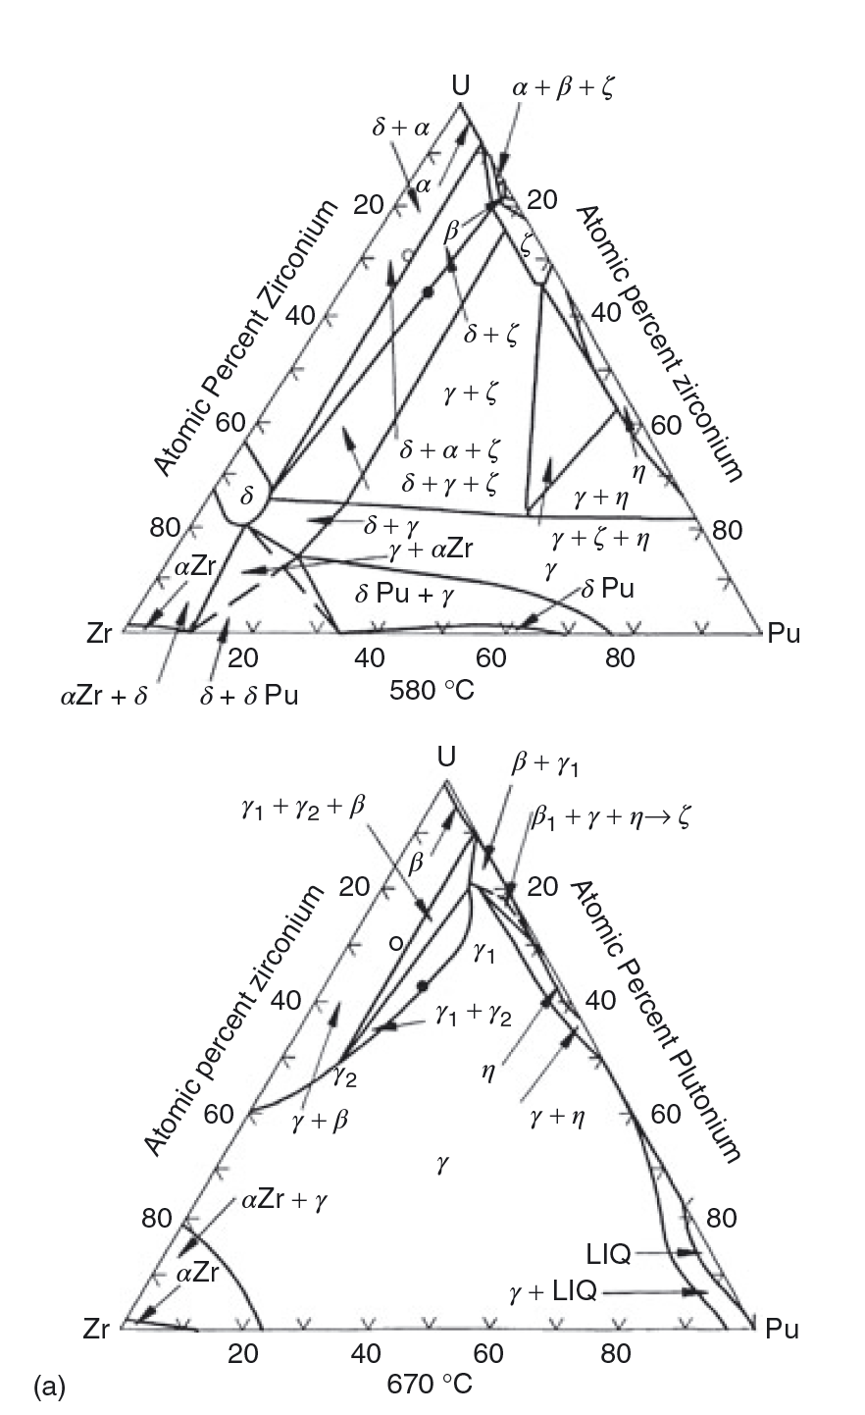
U-Pu-Zr Phases
Various phase boundaries exist radially across the fuel
The solubility of Zr in these phases varies with temperature; thus, a driving force for diffusion can be created both by the gradient in chemical potential, and by the temperature gradient

Slide 4
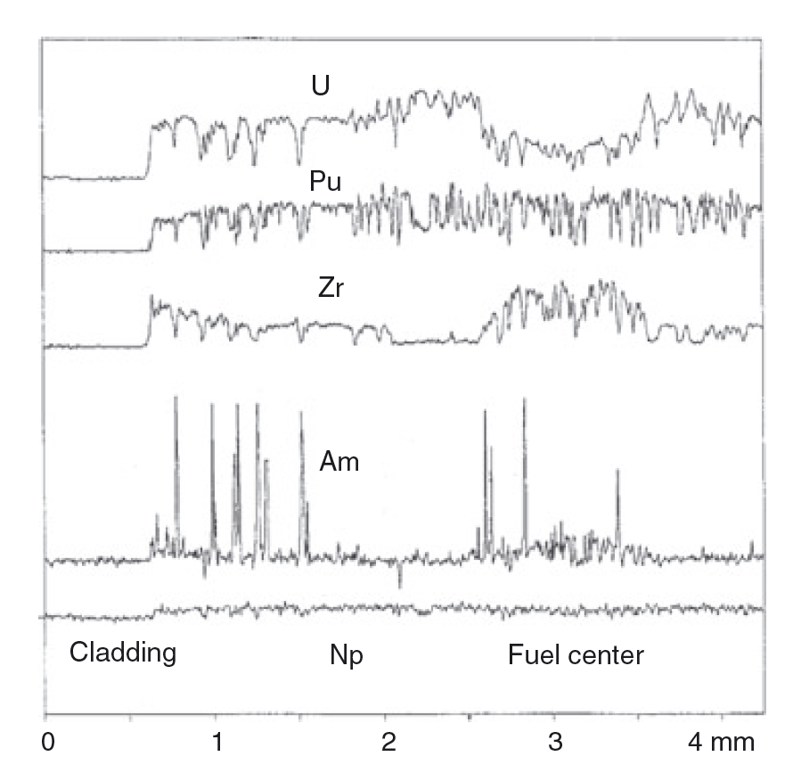
Redistribution
There can exist three compositional regions: 1) enriched Zr, 2) depleted Zr, 3) as-fabricated Zr
Zirconium diffuses up the temperature gradient to the high temperature gamma phase, leaving the intermediate temperature beta U phase
Uranium compensates by diffusing to the intermediate region
At lower T, decomposition into alpha/delta phases – with local low and high Zr content

Slide 5
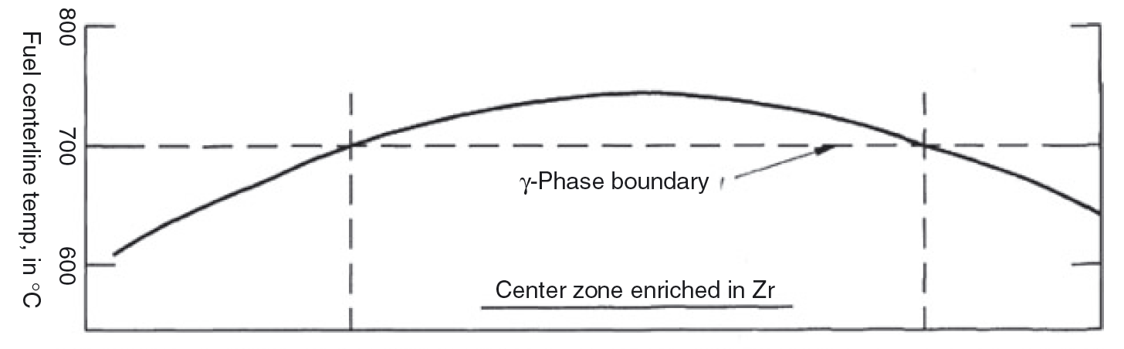
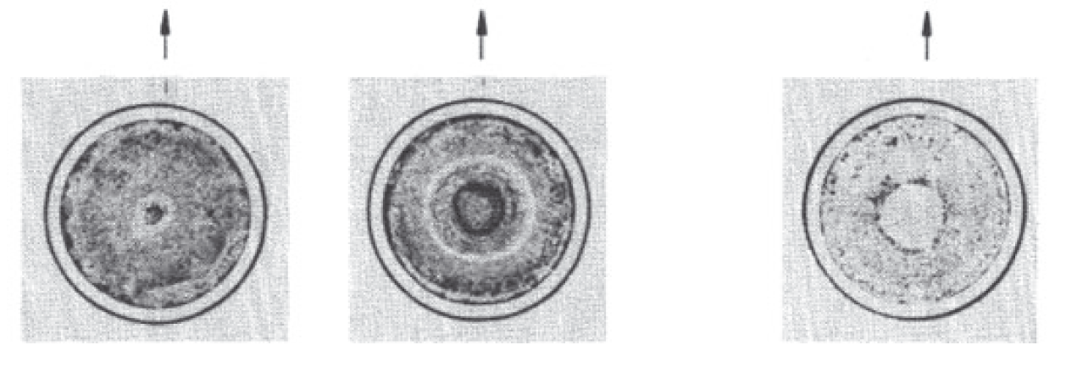
Redistribution
The location of the radial zones essentially follows isotherms in the fuel which are determined by the various phase boundaries of the alloy
The extent of redistribution, and the radial location of the individual compositional regions, varies axially with temperature
Both chemical potential and Soret effect diffusion contribute

Slide 6
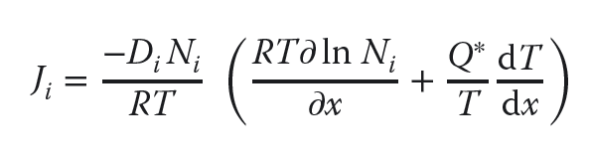
Soret Diffusion
Soret effect is a phenomenon observed in mixtures of mobile particles where the different particle types exhibit different responses to the force of a temperature gradient
The solute flux in a temperature gradient is characterized by the heat of transport, Q*, of the migrating solute according to Fick’s law:
where Di and Ni are the diffusivity and concentration of the migrating solute
The heat of transport can be either positive or negative, depending on the sign and magnitude of its components

Slide 7
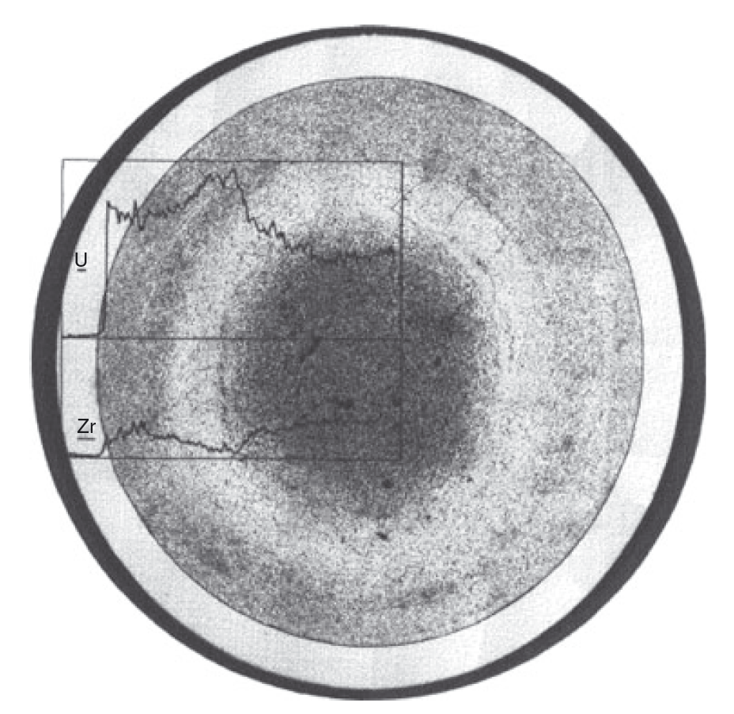
Soret Diffusion in UZr
The value of Q* for pure U was measured to be +5 kcal/mol and to be −34 kcal/mol for Zr
Thus, in their pure states, U moves down a temperature gradient while Zr moves up, but it is unknown if this behavior directly translated to U-Zr alloys
For low Pu content alloys, the rate of redistribution is similar to UZr

Slide 8
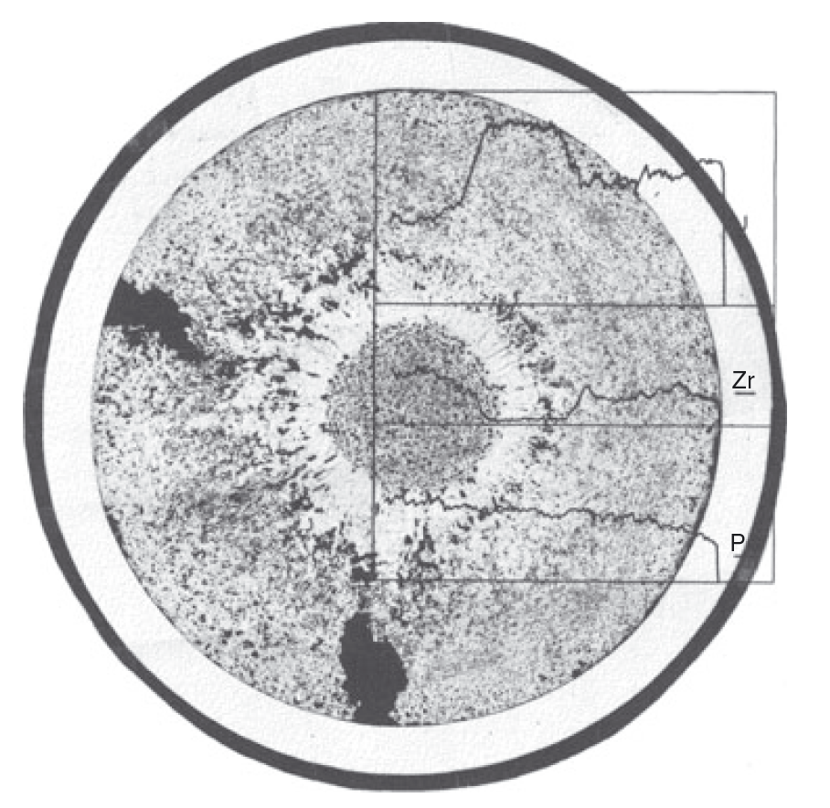
Soret Diffusion in UZr
For high Pu content alloys (>19%), redistribution is much more rapid
At the right is a 3% burnup fuel slug at a similar power density to the U-Zr slug in the previous slide
There is either a higher chemical driving force, or more rapid Zr diffusion present in these alloys
This more rapid redistribution can lead to greater anisotropic swelling, and thus more rapid radial swelling

Slide 9
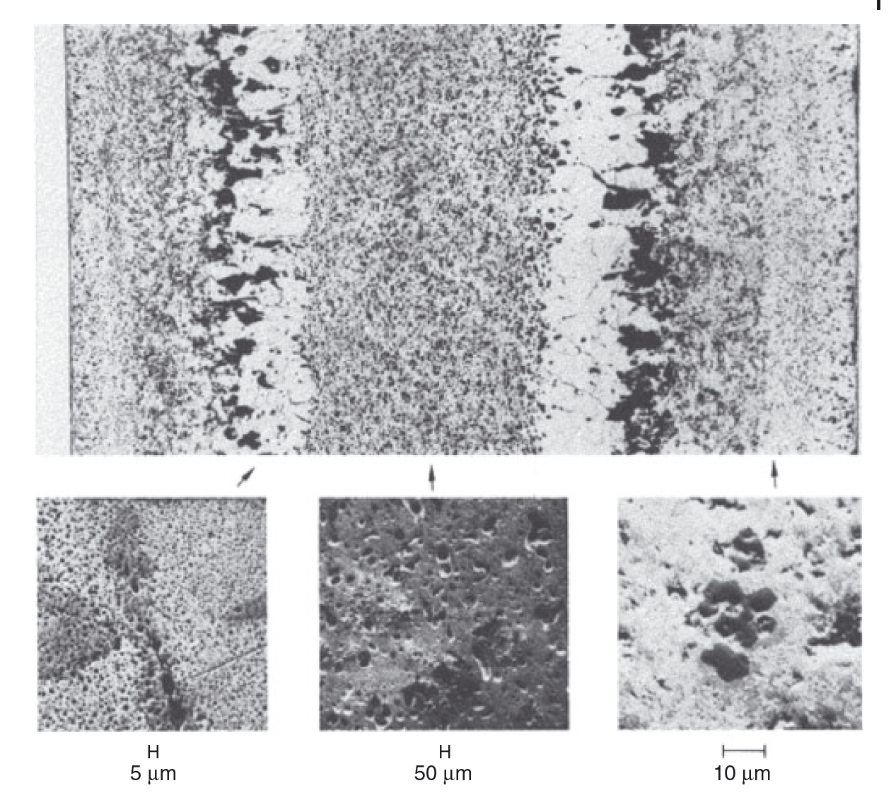
Variable Porosity
The porosity development depends on the phases present in the fuel
In all alloys, the high-temperature cubic U γ-phase exhibits the characteristic large interconnected bubbles similar to those observed in pure γ uranium
Different bubble sizes, densities, and morphologies can exist depending upon the local phase

Slide 10
Variable Porosity
In U-Zr alloys, low-temperature U alpha phase and UZr2 delta phase form a laminar microstructure and the pore morphology follows this microstructure

Slide 11
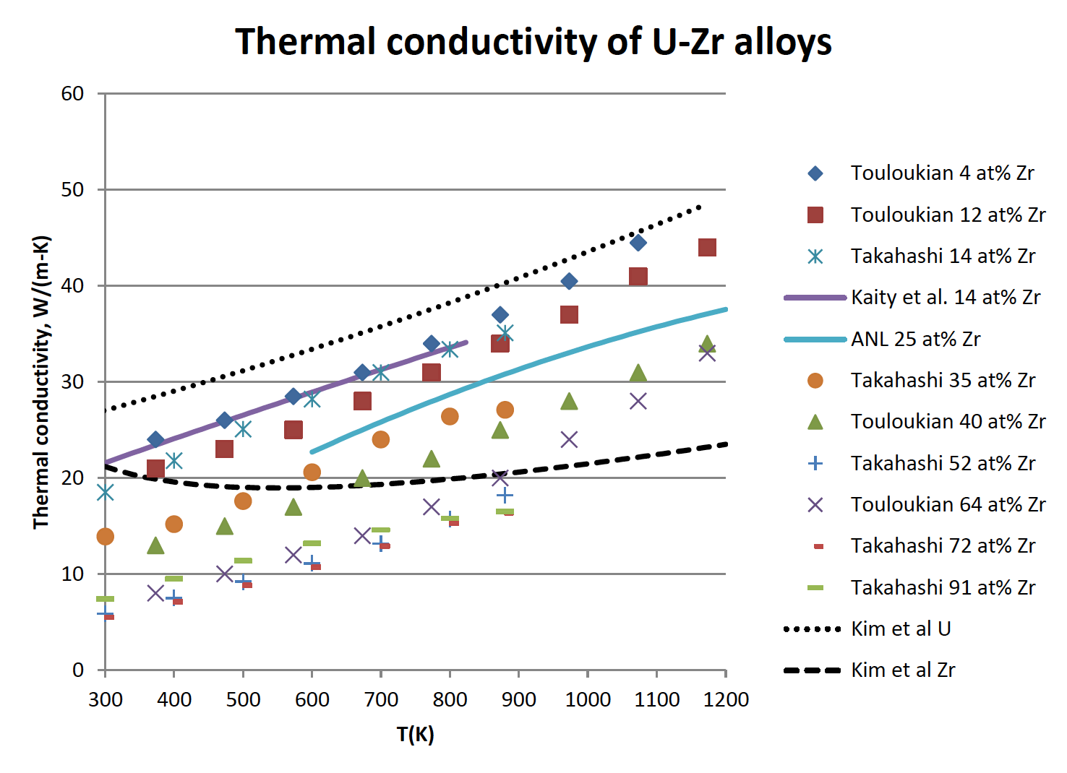
Changes in Thermal Conductivity
U-Zr has a very high thermal conductivity compared to oxide fuels
However, developing porosity will degrade the thermal conductivity
Understanding the temperature also governs how our porosity will develop and how redistribution will vary axially
This is a coupled problem that is complex, but critical for prediction of fuel evolution

Slide 12
Changes in Thermal Conductivity
Bond sodium plays an important role on the thermal behavior of the fuel during irradiation
At the point where the fuel reaches its maximum swelling the porosity in most of the fuel interconnects and gas is vented to the plenum
This allows the bond sodium to infiltrate the fuel body and increase the fuel’s overall thermal conductivity
Sodium infiltration is known because in PIE, the sodium level above the fuel elements, where the fuel has swelled out to the cladding, is always substantially lower than the total amount of preloaded sodium would indicate
Chemical analysis of irradiated fuel finds this “missing” sodium distributed throughout the fuel pin

Slide 13
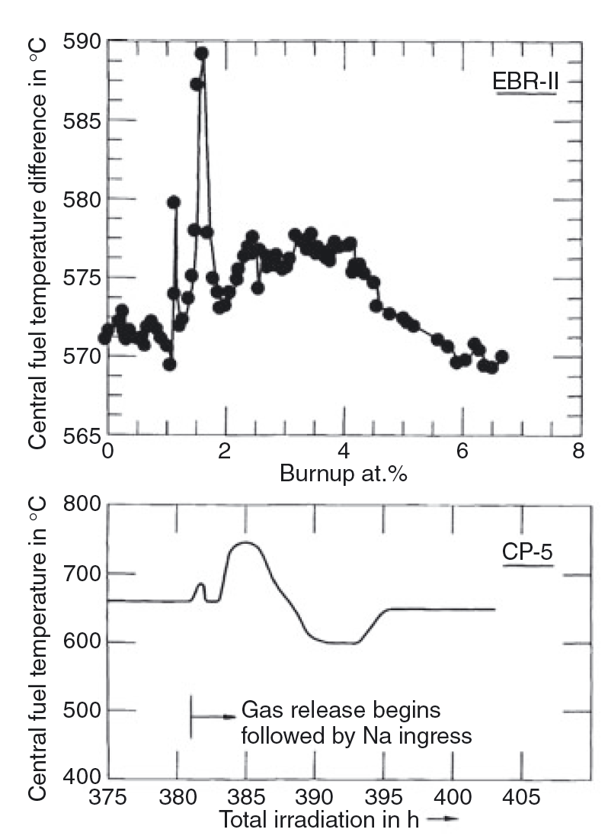
Changes in Thermal Conductivity
On average, approximately 15–20% of the porosity is (filled) with sodium
The overall thermal conductivity of the fuel drops continuously during the early free-swelling stage, due to porosity development, but then increases rather suddenly with gas release and sodium logging
Experiments at right had thermocouples in the center of the fuel

Slide 14
Fuel-Cladding Interaction
Fuel-Cladding interactions are both mechanical and chemical in nature (FCMI and FCCI)
FCMI results from when the fuel swells, comes into contact with the cladding, and exerts an outward force on the cladding
Early element designs did not allow the fuel sufficient free swelling, this gas bubble pressure was transmitted directly to the cladding
Thus, all early designs suffered from cladding deformation and rupture at modest burnups
This was one of the primary reasons oxide fuels were pursued over metallic alloys
By the time the smear density solution had been implemented, metallic fuels had already been left behind

Slide 15
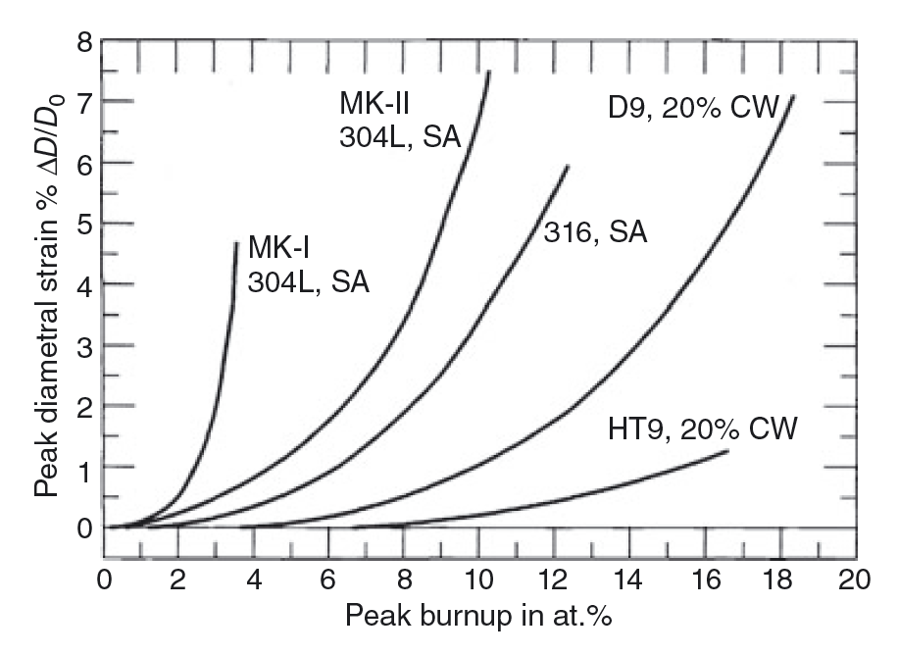
Fuel-Cladding Mechanical Interaction
The cladding strain of low smear density, small plenum fuel rod designs is primarily creep strain due to FCMI (MK-I)
The cladding strain of high smear density, large plenum rods is mainly irradiation-induced cladding swelling (MK-II)
The creep strain can be accounted for by the plenum pressure stress alone, which confirms that FCMI is virtually nonexistent in suitably designed metallic fuel elements
Significant FCMI can be avoided to high burnup if the as-built fuel smeared density is kept to 75%, and a sufficient gas plenum is employed

Slide 16
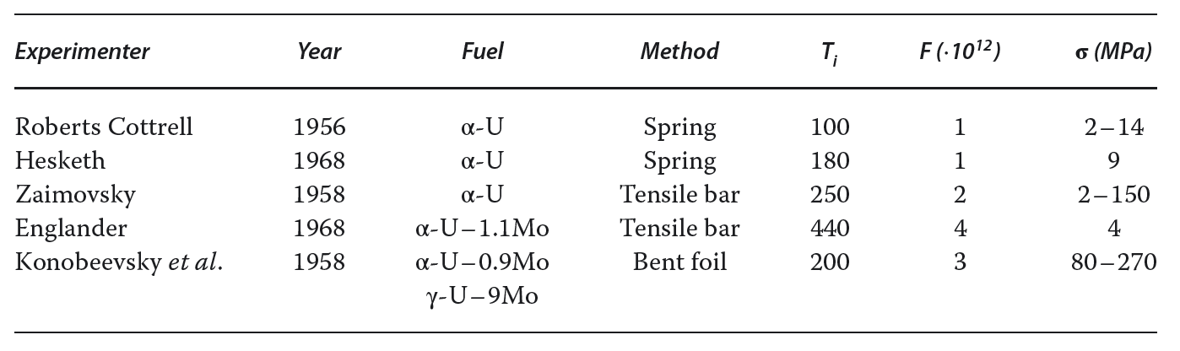
Fission-Induced Creep
Stress in the cladding due to fuel swelling will thus also depend on the effective creep rate of the fuel in-reactor
Measurable creep deformation of α-U during fissioning at temperatures where classical creep does not exist has been experimentally identified
These studies clearly established that at low temperature, the in-reactor creep rate of U is independent of temperature and linearly dependent on both stress and fission rate

Slide 17
Fission Product Swelling
Post-irradiation examinations of high burnup fuel appear largely to support both partitioning into subgroups and assumptions of fission product behavior
A reason for partitioning these fission products is their different migration behavior in the fuel; such grouping allows an evaluation of this migration on the properties of the various radial phasal zones
Zr, Nb, and Mo are all in solution in the fuel phases
Alkali elements (Cs) are dissolved to some extent in the bond sodium
The noble metals (Pt) precipitate as compounds
The rare earths (Nd) precipitate as a separate compound or alloy
The majority of the alkaline (Sr) earths precipitate separately

Slide 18
Fission Product Swelling
The accommodation of the nonsoluble fission products predictably results in a volume expansion as a function of burnup
As U and Pu are removed from the lattice as they fission, this results in a volume decrease that partially offsets the volume expansion due to fission products
Since Zr, Nb and Mo are soluble in the matrix, this compensates for some of the volume decrease due to the disappearance of U and Pu
The result of these contributions is an associated volume change of 0.2 vol.% per percent burnup

Slide 19
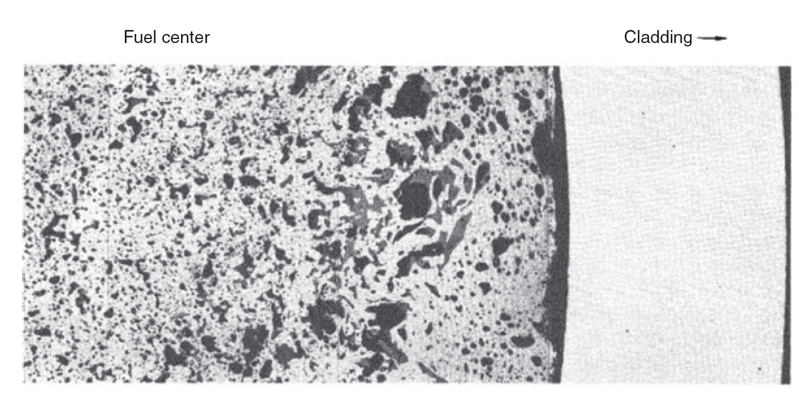
Fission Product Swelling
The rare earths are found to collect in two separate phases in primarily large pores towards the periphery of the fuel and in gaps between the fuel and cladding
A chemical analysis of the bond sodium indicated that a major fraction of the alkali, and also some of the alkaline earth elements, can simply be added to the bond sodium volume

Slide 20
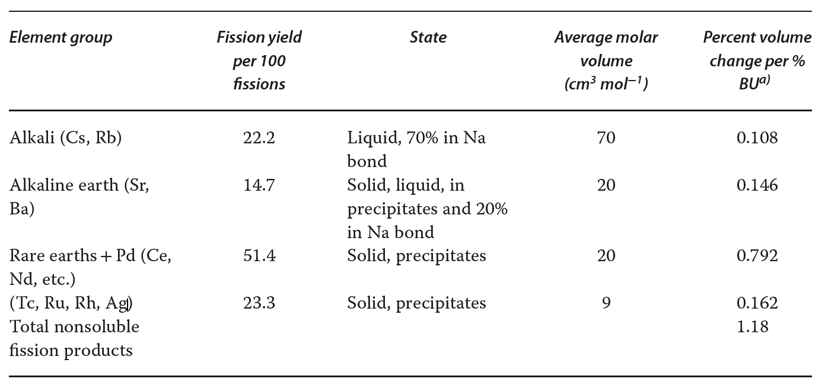
Fission Product Swelling
The total volume of the nonsoluble fission products amounts to approximately 1.2% fuel volume increase per percent burnup

Slide 21
Fuel-Cladding Chemical Interaction
FCCI is a complex multicomponent diffusion and thermodynamic problem
The characterization of fuel-cladding interdiffusion is exceedingly difficult because of the number of alloy components involved
Fuel element species, minor alloy additions (C, N, O) and fission products all play a role in FCCI
The potential problem of interdiffusion of fuel and cladding components is essentially twofold: (i) a weakening of the cladding’s mechanical properties; and (ii) the formation of relatively low melting point compositions in the fuel
Typically, diffusion couple experiments have been performed to try to evaluate these effects

Slide 22
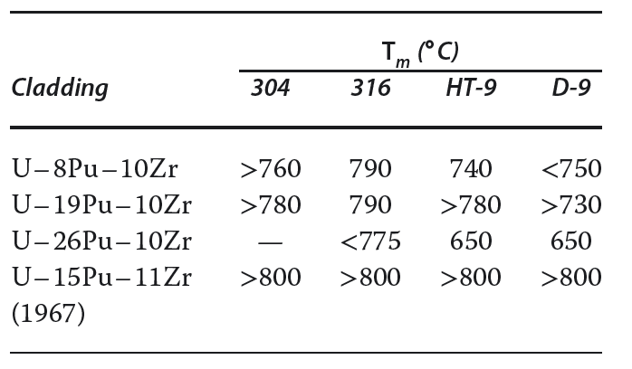
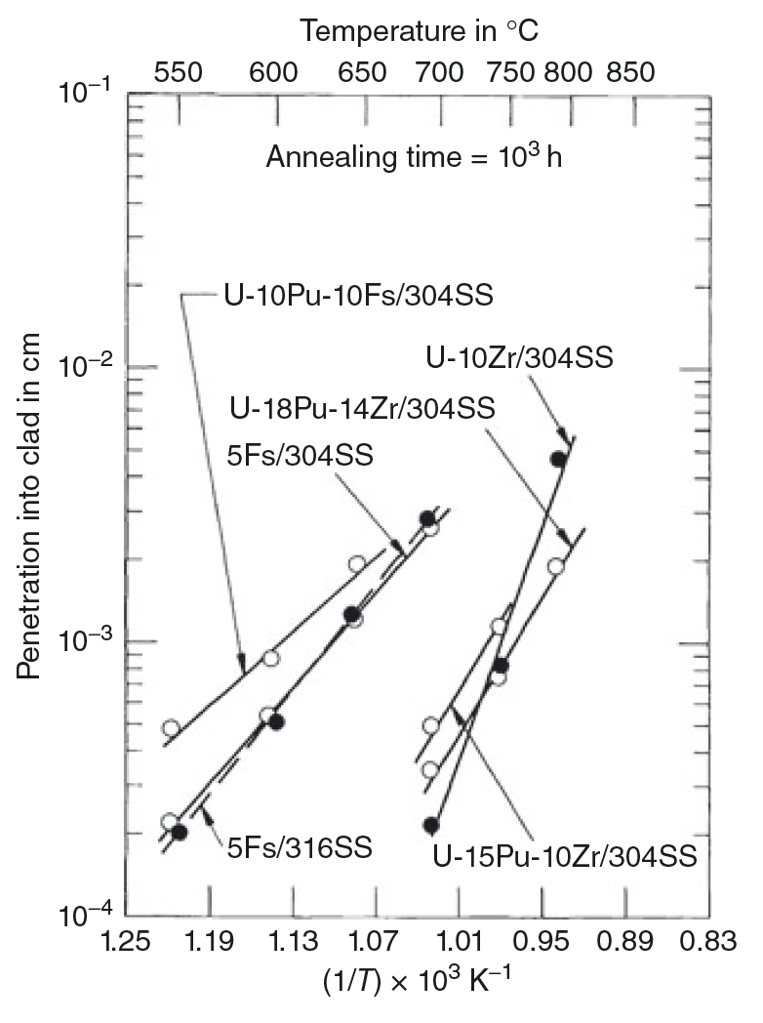
Fuel-Cladding Chemical Interaction
Experiments in the 1960s showed that the addition of Zr showed a decrease in diffusion rates and an increase minimum melting temperature
Additions of Pu accelerate the rate of attack and low possible melting points
This is one of the basis for which Zr was selected as the alloying element for “modern” metallic fuel

Slide 23
Phase Diagrams for FCCI
To gain initial insight into the phases that may develop at the FC interface, one can look at available equilibrium phase diagrams, even though the irradiation process deviates from equilibrium
Phase diagrams can indicate the intermetallic phases present, the solid-solubility ranges in different phase regions, and the temperatures and compositions at which liquid phases develop
The intermetallic phases that are present in phase diagrams can form in the interaction zones during the interdiffusion process; wide ranges of solubility in terminal alloys can be an indication that interdiffusion rates may be high; and knowing the compositions of the low-melting phases is beneficial provides knowledge of potentially limiting conditions

Slide 24
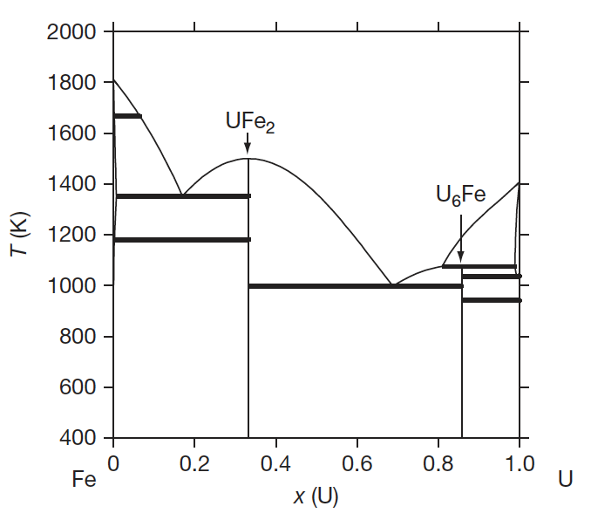
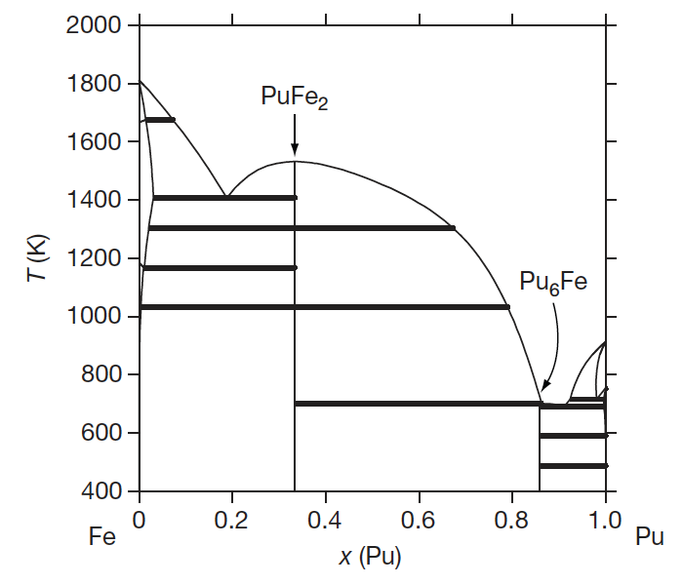
Phase Diagrams for FCCI
The U-Fe and Pu-Fe phase diagrams
Intermetallic UFe2 and U6Fe phases are present in the U–Fe phase diagram and PuFe2 and Pu6Fe phase are present in the Pu–Fe system
These are likely phases to form
These systems also undergo eutectic melting at temperatures as low as ~700K

Slide 25
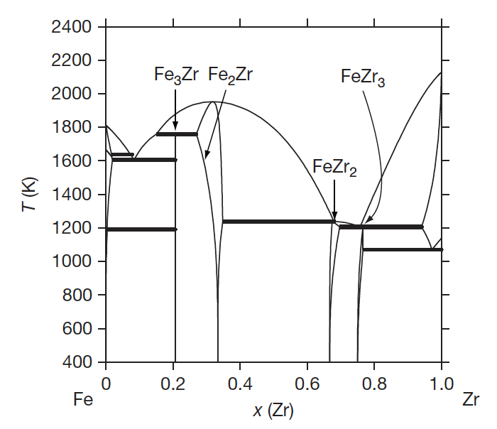
Phase Diagrams for FCCI
Addition of Zr towards U-Fe-Ze and U-Pu-Fe-Zr phase diagrams
Fe3Zr, Fe2Zr, FeZr2, and FeZr3 are intermetallic phases capable of forming in the FCCI zone
Continuous solid solutions have been reported between Pu6Fe and U6Fe and between PuFe2 and UFe2 2: (U,Pu)6Fe and (U, Pu)Fe2

Slide 26
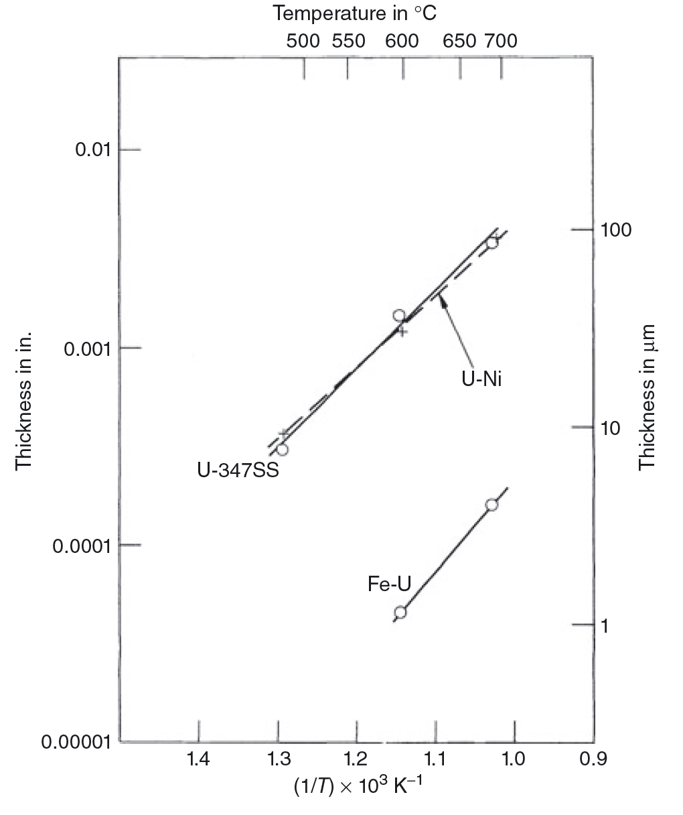
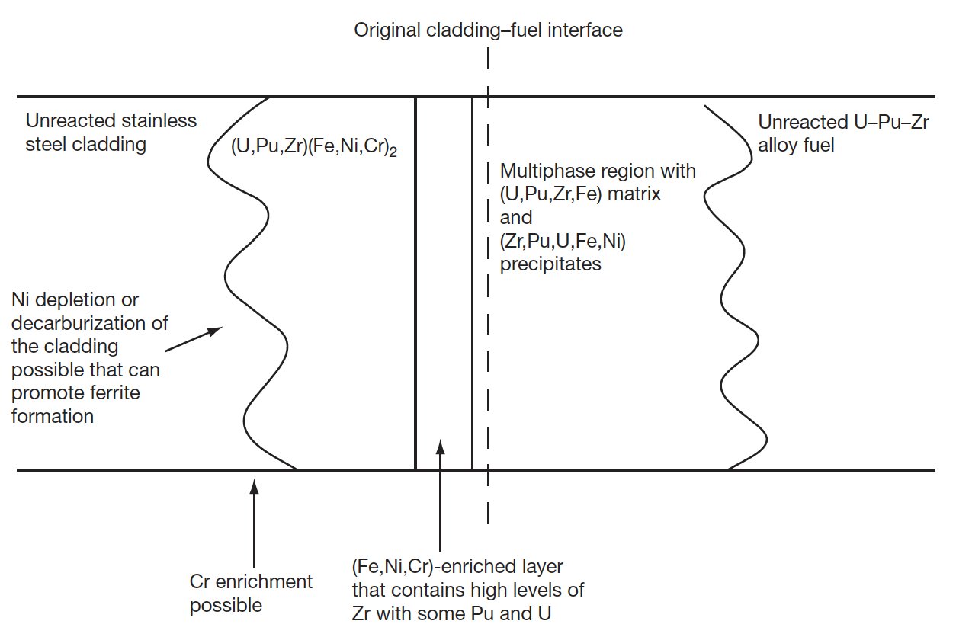
Diffusion Couples
Out-of-pile diffusion couple experiments are typically conducted to determine the interdiffusion behavior of the various constituents at a temperature of interest
Test have been performed with U–Fs, U–Pu–Fs, U–Zr, and U–Pu–Zr and different cladding alloys
Diffusion couple experiments have indicated that a eutectic phase can form in FCCI zones at temperatures near 700C, and this phase is similar to U–Fe6

Slide 27
Protective Rind
Impurities in the fuel or cladding alloys have been suggested to play a role in determining the FCCI behavior
If enough impurities are present (e.g., C, O, or N), then Zr-rich layers that are stabilized by impurities can develop at the interface and impede the interdiffusion process
The extent of the formation would depend on the oxygen activity in the cladding
Work has been performed on U–Zr alloys to investigate the development of nitride layers with a N2 cover gas
This has been related to the rind and rind interactions with FCCI
The rind can form during a casting process due to the atmosphere and crucible/mold
It form on the exterior of the fuel slug, almost like a coating

Slide 28
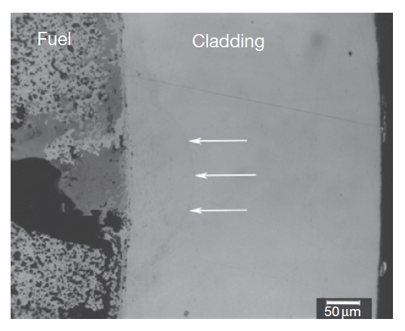
FCCI
The interaction zone formation in irradiated metallic fuel elements is localized
Typically, the largest interaction zones in fuel elements are created when a wedge-shaped crack forms in the fuel adjacent to the inner surface of the cladding and a large fission product deposit (primarily Nd, Ce, and La) develops

Slide 29
FCCI
In many of the analyzed fuel elements, fuel–cladding interaction can be linked to the integrity of the Zr-rind
In the image, arrows indicate areas where rind is no longer intact
Both temperature and power variations along the length of a fuel element appear to impact the amount of fuel–cladding interaction that will occur
The maximum fuel–cladding interaction is observed in the combined high-temperature and high-power region of a fuel element

Slide 30
FCCI
The burnup of a fuel pin is another parameter that impacts the size of the fuel–cladding interaction zone
Larger interaction zones are observed for higher burnup fuel elements
The larger inventories of fission products allow more lanthanides to diffuse down the temperature gradient, thereby increasing the inventory of fission products at the interface
For high burnup fuels, temperature effects also exacerbate FCCI due to thermal cond. degradation producing higher temperatures, and more rapid FP diffusion
Fuel elements at the hotter core positions can exhibit increased interdiffusion at the fuel–cladding interface over those at colder positions

Slide 31
Summary
Radial redistribution of chemical species driven by thermodynamics and Soret diffusion
Include large plenum to accommodate fission gas release
Thermal conductivity degradation
fission gas swelling/porosity, sodium infiltration
Fuel-cladding mechanical interaction
fuel swelling, creep, internal pressure, etc.
Fuel-cladding chemical interaction
phase diagrams and kinetics, low melting points, intermetallics, etc.

Slide 32
Questions?

